Slide 1
Statistics and Error Analysis
MET Design
March 15, 2019

Slide 2
What is Statistics?
Statistics is the scientific application of mathematical principles to the collection, analysis, and presentation of data.
deals with
Collection
Presentation
Analysis
Use
to
make decisions and solve problems
Statistics
data
Engineering statistics is the study of how best to…
  Collect engineering data
  Summarize or describe engineering data
  Draw formal inferences and practical conclusions on the basis of engineering data.

Slide 3
Engineering Statistics
is the branch of statistics that has three subtopics which are particular to engineering.
Design of experiments (DOE)
  A systematic method to determine the relationship between factors affecting the process and the output of that process. (cause and effect relationships).
Quality control and process control
  use statistics as a tool to manage conformance to specifications of manufacturing processes and their products.
Time and method engineering
  use statistics to study repetitive operations in manufacturing in order to set standards and find optimum (in some sense) manufacturing procedures.

Slide 4
Types of data
Qualitative Data (Categorical)
  Non-numerical characteristics associated with items in a sample
  Examples:
    Eye color (blue, brown, green, etc)
    Engine status (working, not working & fixable, not working & not fixable)
Quantitative Data (numerical)
  Numerical characteristics associated with items in a sample
  Typically counts of occurrences of a phenomenon of interest or measurements of some physical property
  Can be further broken down into discrete (countable) and continuous (uncountable)

Slide 5
Some Statistical Terms
Mean: arithmetic average
  …sum of all observations divided by # of observations.
Median: value midway in the frequency distribution
  …half the area of curve is to right and other to left
Mode: value that occurs most frequently in a distribution (usually the highest point of curve) may have more than one mode in a dataset
Range: measure of dispersion about mean (maximum minus minimum)

Slide 6
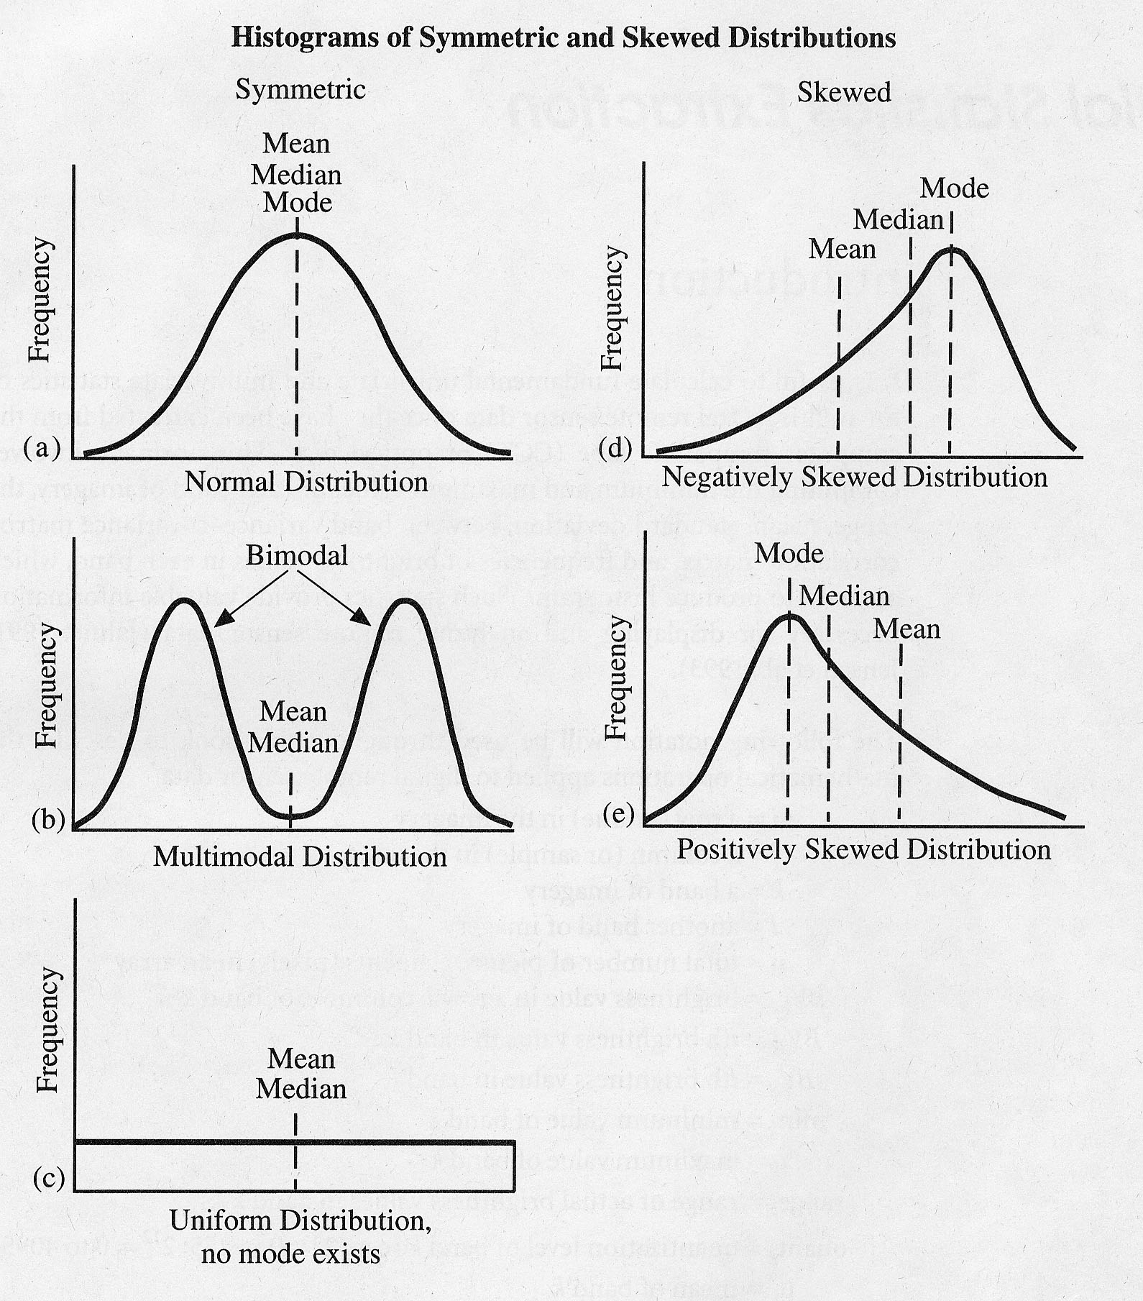
Graphical Representation
Many statistical tests assume values are normally distributed.
Not always the case !
Examine your data prior to processing.

Slide 7
Variance
  Variance is the average squared deviation from the mean of a set of data.
  It is used to find the standard deviation.

Slide 8
Variance
1. Find the mean of the data.
Subtract the mean from each value – the
result is called the deviation from the mean.
3. Square each deviation of the mean.
4. Find the sum of the squares.
5. Divide the total by the number of items.

Slide 9
Variance Formula
The variance formula includes the Sigma Notation, which represents the sum of all the items to the right of Sigma.
Mean is represented by and n is the number of items.

Slide 10
Standard Deviation
Standard Deviation shows the variation in data. If the data is close together, the standard deviation will be small. If the data is spread out, the standard deviation will be large.
Standard Deviation is often denoted by the lowercase Greek letter sigma, .

Slide 11


The bell curve which represents a normal distribution of data shows what standard deviation represents.
One standard deviation away from the mean ( ) in either direction on the horizontal axis accounts for around 68 percent of the data. Two standard deviations away from the mean accounts for roughly 95 percent of the data with three standard deviations representing about 99 percent of the data.

Slide 12
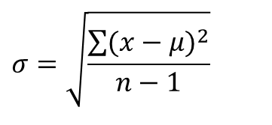
Standard Deviation Formula
The standard deviation formula can be represented using Sigma Notation:
Notice the standard deviation formula is the square root of the variance.
Note: Use n-1 for samples of a population:
$$σ=\sqrt{\frac{\sum{(x−μ)^{2}}}{n−1}}$$

Slide 13
Collection of quantitative data (Measurement)
If you can’t measure, you can’t do statistics… or engineering for that matter!
Issues:
  Validity
  Precision
  Accuracy (unbiasedness)

Slide 14
Measurement issues
Validity – validity refers to whether a study is able to scientifically answer the questions it is intended to answer.
Precision – small variation in repeated measurements
Accuracy (unbiasedness) – producing the “true value” “on average”

Slide 15

Precision and accuracy
Accurate, Not Precise
Not Accurate Not Precise
Precise, Not Accurate
Accurate and Precise

Slide 16
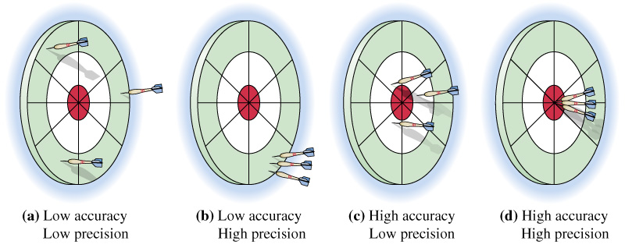
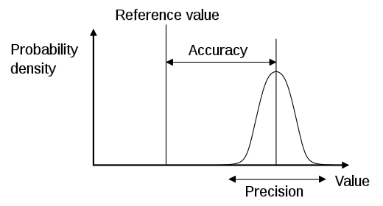
Graphically

Slide 17

Statistical thinking
Statistical methods are used to help us describe and understand variability.
By variability, we mean that successive observations of a system or phenomenon do not produce exactly the same result.
Are these gears produced exactly the same size?

Slide 18

Method
Environment
Man
Material
Sources of variability
Machine

Slide 19
Uncertainties
In every measurement there is uncertainty.
Why
  Measuring devices
  Experimental procedure and technique
  Nature of the measurement itself
    Difficult (Eg: speed of light)

Slide 20
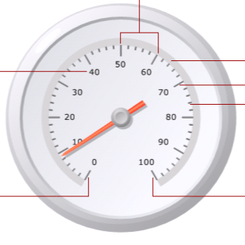
Measurement Uncertainty
Scale Interval
Scale
Label
Scale Bar
Major tick
Minor tick
Scale
Minimum
Scale
Maximum
Reading → 9 ± 1

Slide 21
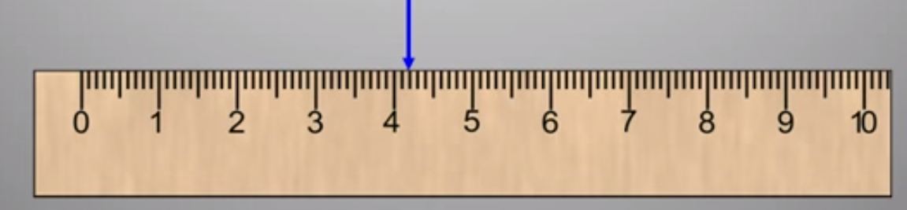
Uncertainty: Analog Devices
cm
± ½ ( the smallest scale division).
4.20 ± 0.05 cm

Slide 22
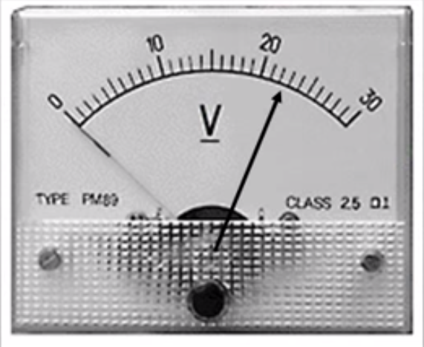
Uncertainty: Analog Devices
22.0 ± 0.5 V

Slide 23
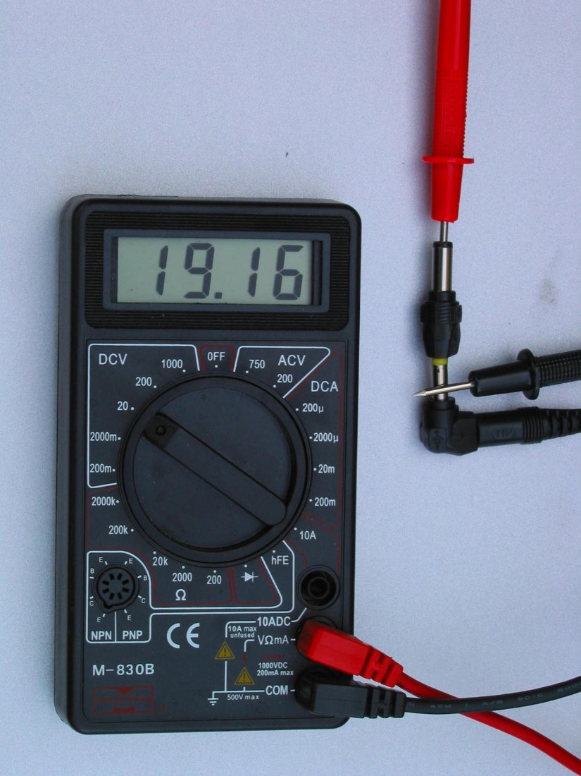
Uncertainty: Digital Devices
± smallest unit shown (or least count).
19.16 ± 0.01 V

Slide 24
Two questions to ask about any measurement
Resolution : What does the measuring device tell you about its resolution (precision). This is also called readability
Repeatability: Standard Deviation.

Slide 25
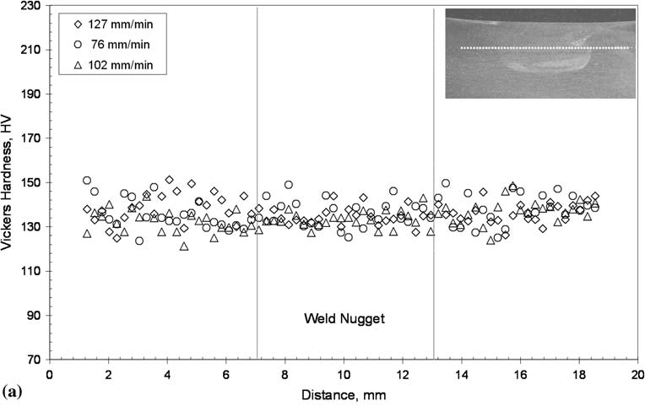
Example

Slide 26
Repeatable Measurement
Uncertainty
Reading
10
11
9
9
11
Mean – 10
Best Estimate of Value → mean = 10
Best Estimate of Uncertainty → Range 9-11
Stating Uncertainties
X ± δX
10 ± 1

Slide 27
Ways to State Uncertainty
Example: Lets say the length of the table to be 1563 ± 5 mm.
The absolute uncertainty is 5 mm.
The fractional uncertainty is 5/1563 = 0.003
The percentage uncertainty is (5/1563) X 100 = 0.3%

Slide 28
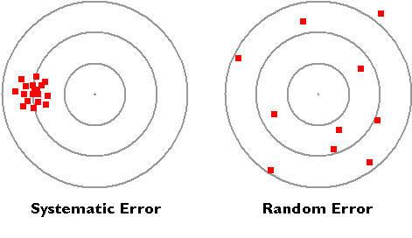
Types of Errors
Systematic
  Displace Mean
  External
Random
  Fluctuate Around Mean
  Noise
  Lack Of Sensitivity

Slide 29
Random Errors
Uncontrollable variation in Measurements
  Different people measure.
  Human reaction time
  Poor experimental techniques
Random errors can be minimized by multiple trials and averaging.

Slide 30
Systematic Errors
All measurements bigger or smaller than the true value by the same amount.
Taking the average will not help
Normally caused by not measuring from zero (also known as “Zero Error”)
  Ammeter needle not on Zero when disconnected
  Micrometer doesn't start at “zero”

Slide 31
Significant Figures
Bad
Good
35.3 ± 0.362781
→
35.3 ± 0.4
35.3103 ± 3
→
35 ± 3
Rule of Stating Answers –Last SF should be same order
of magnitude as uncertainty; Include units

Slide 32
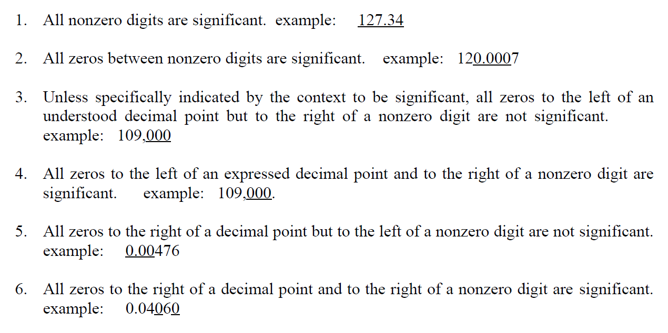
Rules for Significant Figures

Slide 33
Determining SFs
Box-and-Dot Method
12301100
12301100
123011
00
6 SF
No decimal point
No trailing zeros
0.01230123100
0.01230123100
0.012301231
00
10 SF
After decimal point
Trailing zeros
00123.013
00
123.013
123.013
6 SF
With decimal point
No trailing zeros
123.01300
123.01300
123.013
00
8 SF
With decimal point
Trailing zeros

Slide 34
To Find Out More
An Introduction to Error Analysis, 2nd Edition, JR Taylor, University Science Books, 1997.
WK Stephenson, “The Box-and-Dot Method: A Simple Strategy for Counting Significant Figures”, J. Chem. Ed., 86(8), pp. 933-935, 2009

Slide 35
Find the mean, median, mode, and range for the following list of values:
13, 18, 13, 14, 13, 16, 14, 21, 13

Slide 36
The test scores of five students in three courses are:
  Test 1: 92,88,80,68 and 52.
  Test 2: 92,92,92,52,52
  Test 3: 77,76,76,76,75
a) Calculate the mean and range of each data set.
b) Calculate the standard deviation of each data set.
c) Which set has the lowest standard deviation?
d) Is it possible to answer question c) without calculations of the standard deviation?

