Slide 1
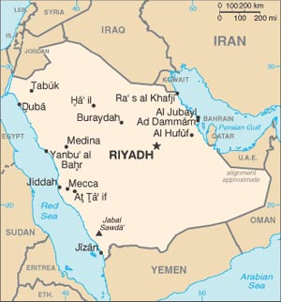
Chapter 7
Power Hungry by Robert Bryce
27 Saudi Arabias Per Day
Presented by Matthew Cagle

Slide 2
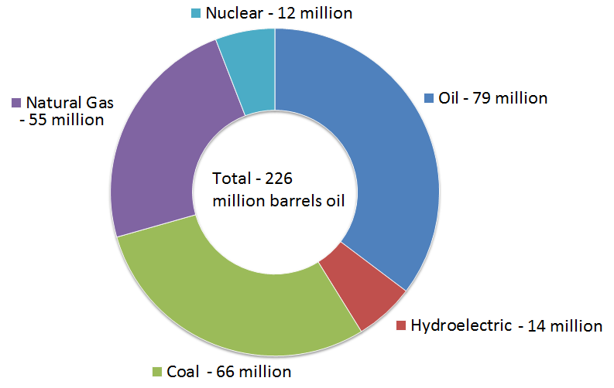
Global daily energy consumption in million barrels of oil equivalent
Source: BP Statistical Review of World Energy 2009, http://www.bp.com/liveassets/bp_internet/globalbp_uk_english/reports_and_publications/statistical_energy_review_2008/STAGING/loval_assets/2009_downloads/renewables_section_2009.pdf

Slide 3
How much is 226 million barrels of oil?
Saudi Arabia’s daily oil production: 8.5 million barrels of oil per day.
Each day, 26.6 Saudi Arabias worth of oil equivalent is consumed

Slide 4
Converting barrels of oil to power
1 barrel of oil = 5.8 million BTU
5.8 million BTU ≈ 5.8 GJ (billion joules)
Remember, Power = Energy/time
5,800,000,000J/86,400 seconds = 22,152 W*Days
22,152 W = 29.7 horsepower.*day
1 barrel of oil ≈ 30 horsepower*Day

Slide 5
World energy consumption
1 barrel of oil ≈ 30 horsepower
Total global daily energy consumption rate is 6.8 billion horsepower
This roughly equals 1 horsepower/person
Energy distribution isn’t even
Note that 1 horsepower ≈ 746 W

Slide 6
Energy consumption per capita
Source: BP Statistical Review of World Energy 2009, http://www.bp.com/liveassets/globalbp/glovalbp_uk_english/reports_and_publications/statistical_energy_review_2008/STAGING/local_assets/2009_downloads/renewables_section2009.pdf; Central Intellegance Angency, World Factbook, https://www.cia.gov/library/publicaitons/the-world-factbook/

Slide 7
United States leads the world in energy production:
1st in Nuclear energy production
2nd in Coal production (behind China)
2nd in Natural Gas production (behind Russia)
3rd in Oil production (behind Saudi Arabia and Russia)
4th in Hydroelectric production

Slide 8
United States Energy Production
United States: - produces 74% of the primary energy it consumes - provides massive amounts of energy to its citizens
Massive energy production and consumption has made the U.S. economy boom

Slide 9
United States Energy Reserves
United States has 970 billion barrels of oil equivalent in reserve (906 billion barrels equivalent is in coal)
Russia has 955 billion barrels of oil equivalent
China is at 466 billion barrels of oil equivalent

Slide 10
References
Bryce, Robert. (2010). Power hungry. New York: PublicAffairs.
CIA World Fact Book, (2010). Saudi arabia. Retrieved from http://www.state.gov/r/pa/ei/bgn/3584.htm

