Slide 1
Myth: Going “Green” Will Reduce Imports of Strategic Commodities and Create “Green” Jobs
Presented By: Nicole Rames

Slide 2
Importance of Lanthanides
“Elements found in the lanthanides’ row of the periodic table are essential commodities in nearly all of the technologies that are seen as solutions to our energy challenges, from wind turbines and hybrid cars to solar panels, computers, and batteries”
Lanthanides (rare earths) have special features at the quantum mechanics level
The configuration of their electrons allows them to have unique magnetic interactions with other elements

Slide 3
Myth vs. Reality
Myth: if only we would use more hybrid cars, wind turbines, solar panels, and others, we would be free of messy international entanglements and the need to import oil and other strategic commodities
Reality: China has a de facto monopoly on the global trade in the lanthanides, and about 90% of the worlds lithium comes from just three countries (Argentina, Chile, and China)
In its headlong rush to go “green,” the US may simply be trading reliance on one type of import (oil) for reliance on another (rare earth and lithium)

Slide 4
China controls between 95-100% of the global market in lanthanides
“All green technology depends on rare-earth metals and all global trade in rare earth depends on China.” – Japan’s Ministry of Economy, Trade and Industry
Of the lanthanides, neodymium has particular significance
Neodymium-iron-boron magnets
Powerful
Lightweight
Relatively cheap (compared to magnets they replaced)

Slide 5
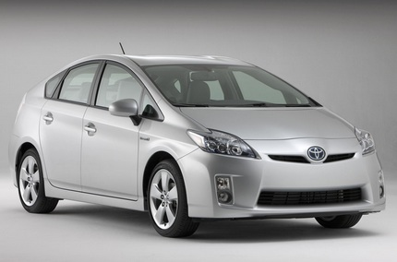
Neodymium and Hybrid Cars
Toyota Prius:
“One of the most rare-earth-intensive consumer products ever made”
Uses neodymium-iron-boron magnets in its motor-generator and batteries
Contains about 2.2 pounds of neodymium
Contains about 22 pounds of lithium
Honda Insight
Ford Fusion

Slide 6
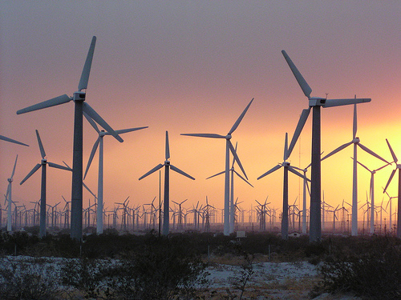
Wind Power Sector
American wind sector is almost wholly dependent on neodymium-iron-boron magnets, which are used inside wind turbines
GE reportedly buys all of these magnets used in its wind turbines from China

Slide 7
Solar Power Sector
Non-lanthanide rare elements are essential
Arizona-based First Solar – one of the biggest producers of photovoltaic cells in the US relies on tellurium (cadmium telluride)
Tellurium is produced as a by product of the copper refining process
According to experts on rare metals, the Chinese have the world’s only tellurium mine
Several Chinese solar-panel factories have boosted their production, dropping the price in the US by 40% between 2008 and 2009

Slide 8
China’s near-monopoly control of the green elements likely means that most of the new manufacturing jobs related to “green” energy products will be created in China, not the US
Chinese companies are “willing to lose money on their solar panels in order to gain market share”
Examples:
Austin Energy
Build a solar farm that will use 220,000 solar panels – all made in China
Wind project in West Texas
Install 240 wind turbines on a 36,000 acre site – all built in China

Slide 9
Summary
The vision of switching to high-tech, hybrid-electric, no-carbon energy depends heavily on lanthanides and lithium, which means mining
China controls nearly all of the world’s existing mines that produce lanthanides
Reality is that the US (like every other country) will continue to depend on the global marketplace to obtain the commodities it needs

Slide 10
References
“Power Hungry” by Robert Bryce
http://www.itechnews.net/2009/02/01/2010-toyota-prius-hybrid-car/
http://www.earthyreport.com/site/wind-and-solar-prices-keep-falling/
http://www.solarenergyfact.org/

