Slide 1
Chapter 19
Myth:
Electric Cars Are the Next Big Thing
by Jonathan Straetker

Slide 2
Electric Car Hype
…”help the world end its addiction to oil by transforming cars from their climate-changing, lung-polluting, gas-guzzling design to one that’s clean, affordable and all electric.”

Slide 3
Pros and Cons
The Positives:
Low refueling costs
No air pollutants at point of use
Quiet operations
The Negatives:
Limited range
Slow recharge rates
Lack of recharge stations
High costs

Slide 4
2009 DOE Energy Storage Report
Costs
“The current cost of Li-based batteries is approximately a factor of three to five too high a kWh basis.”
Abuse Tolerance
“Many Li batteries are not intrinsically tolerant to abusive conditions such as a short circuit, overcharge, over-discharge, crush, or exposure to fire and/or other high temperature environments.”
Life
“The ability to attain a 15-year life…or 5000 EV cycles are unproven and are anticipated to be difficult.”
Performance
“The performance barriers include the need for much higher energy densities to meet the volume/weight requirements…”

Slide 5
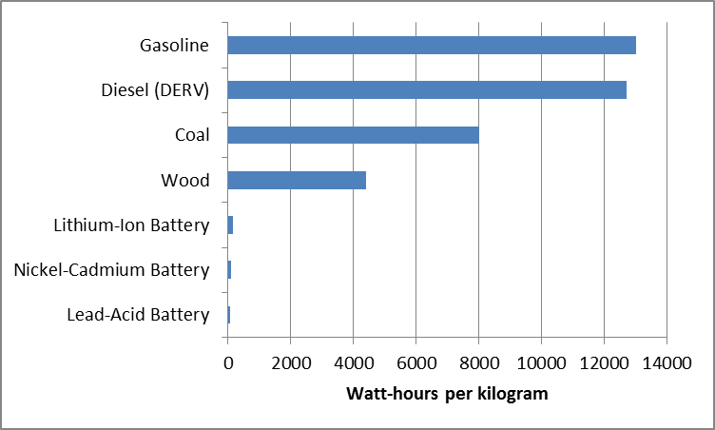
Energy Density
Data obtained from Sustainable Energy – without the hot air

Slide 6
Future Vehicles
Electric powertrains with advanced energy storage technology (batteries and ultracapacitors)
Internal Combustion driven
Increase use of diesel

Slide 7
Work Cited
Bryce, Robert Power Hungry: The Myths of ‘Green’ Energy and the Real Fuels of the Future, New York: Public Affairs. 2010
MacKay, J.C. Sustainable Energy – without the hot air , Cambridge: UIT Cambridge Ltd. 2009, http://www.inference.phy.cam.ac.uk/sustainable/book/tex/cft.pdf 19-March-2011

Slide 8
Questions

