Slide 1
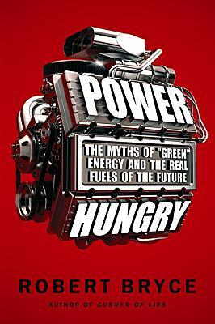
Chapter 21 WHY N2N? AND WHY NOW?
Adam Well

Slide 3
Reducing Carbon Emissions
Chapter 21
Decarbonization- “Ongoing global trend toward consumption of fuels that contain less carbon”.
Reducing the Carbon to Hydrogen Ratio

Slide 4
Carbon to Hydrogen Ratio
Chapter 21
C:H = Carbon-to-burnable Hydrogen
Wood 10:1
Coal 2:1
Oil 1:2
Natural gas (methane CH₄) 1:4
“Chemical formula (CH₄) suggests, has a ration of 1:4 or 1 Carbon atom for every 4 Hydrogen”

Slide 5
Reserves or Resources
Chapter 21
Reserve-“only applies to in-the-ground hydrocarbons that have been surveyed by drilling and other agreed-upon techniques”.
Resources- “is something that’s probably out there”.

Slide 6
How Much Oil – How Much Natural Gas
Chapter 21
At current rates of extraction its estimated that Oil will last another 42 years
At current rates of extraction its estimated that Natural Gas will last more than 60 years
This number will increase as more gas resources get moved to the reserves category

Slide 7
Peak Oil
Chapter 21
Peak oil – peak world oil production
Reaching peak oil means “The price of oil will have to be whatever is required to cause total consumption to decline”

Slide 8
Summary
Chapter 21
“But N2N offers the most viable way to hedge our bets with regard to both peak oil and peak coal. To be sure, both oil and coal will continue to be key sources of primary energy throughout the world for the rest of the twenty-first century, but it is also apparent that the inevitable production plateaus of those fuels will force consumers to find alternatives. And natural gas and nuclear power are the only alternatives that can provide the scale of energy supplies needed to substitute for some of the expected declines in oil and coal production. In other words, natural gas and nuclear power can be used as a hedge against the looming “twin peaks””.

Slide 9
References
Chapter 21
"File:Power-hungry.jpeg." Wikipedia, the Free Encyclopedia. Web. 22 Mar. 2011. <http://en.wikipedia.org/wiki/File:Power- hungry.jpeg>.
Bryce, Robert. Power Hungry: the Myths of "green" Energy and the Real Fuels of the Future. New York, NY: PublicAffairs, 2010. Print.

Slide 10
Questions?
Chapter 21

