Slide 1
Chapter 23
It’s a Gas, Gas, Gas
Welcome to the Gas Factory
Rob Lower

Slide 2
Natural Gas Deposits
Hillsboro, Texas
Barnett Shale Deposit
’97 finely found an effective way to mine the gas out of shale
Shale Gas is easier to find
Barnett Shale Deposit already has “children”(discovery and development of similar sized fields)

Slide 3
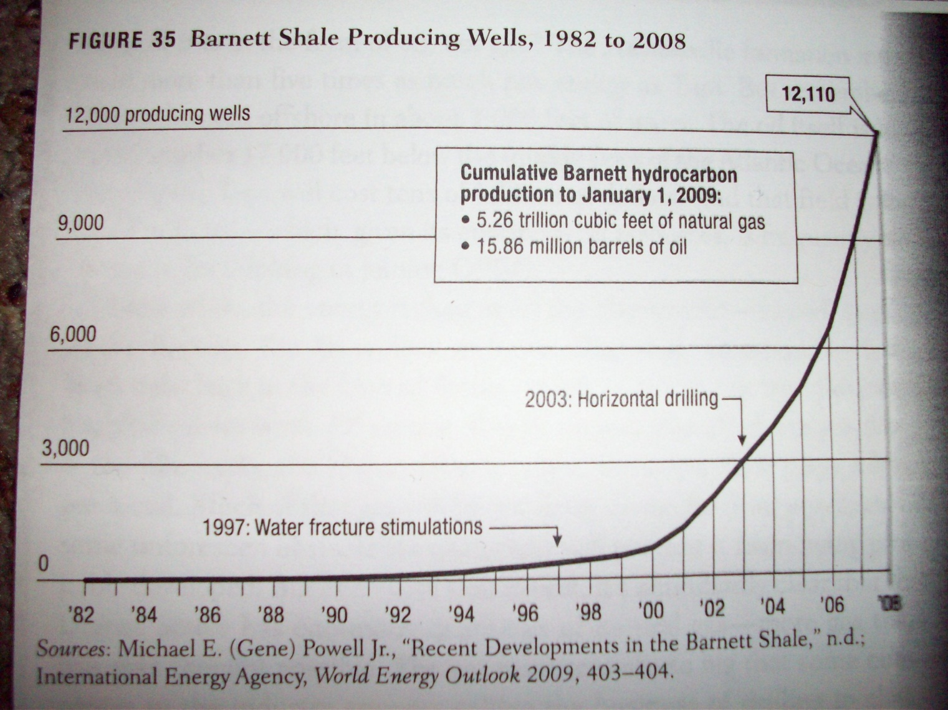
Wells on Barnett Shale Deposit

Slide 4
Amount of recoverable natural gas from shale in the U.S.
649.2trillion cubic feet
Marcellus: 262 trillion
Haynesville 251 trillion
Barnett 44 trillion
Tupi Shale Deposit
off the shore of Brazil
cost more to produce if it ever has to be used
7,000 feet of water
17,000 feet of mud
Brazil has so much oil they have little interest in trying to access the Tupi Shale Deposit

Slide 5
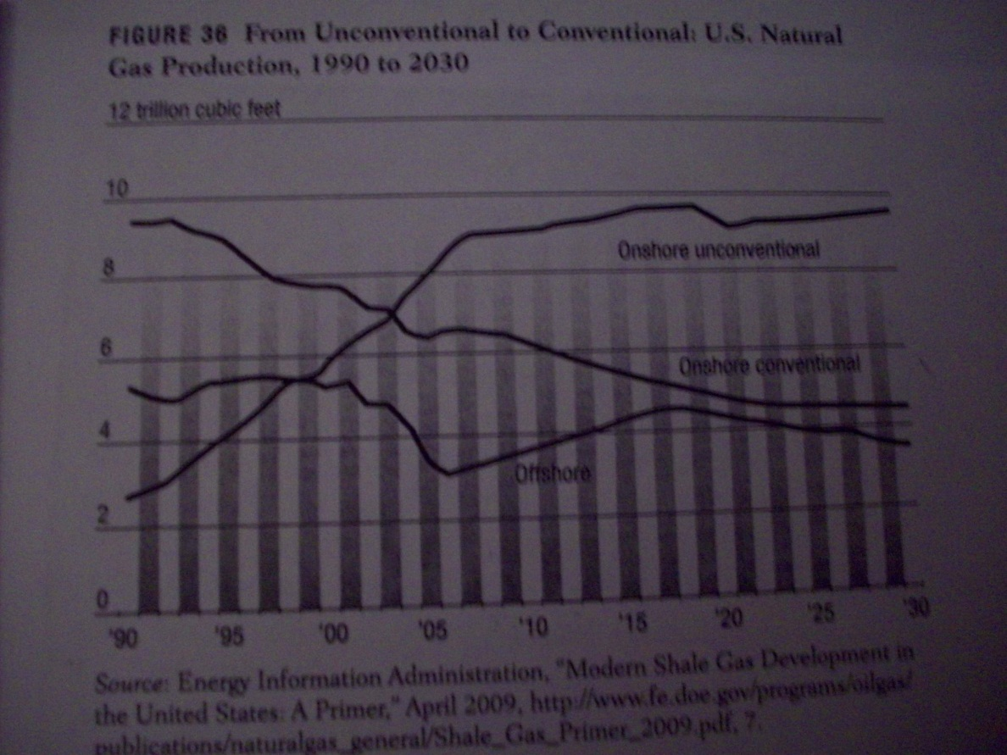
U.S. Natural Gas Production (1990-2030)

Slide 6
References
Bryce, Robert. Power Hungry: the Myths of "green" Energy and the Real Fuels of the Future. New York, NY: PublicAffairs, 2010. Print.

Slide 7
Questions?

