Slide 1
Myth: Wind and Solar are Green
Presented by: Brett Carlson

Slide 2
What is Green?
“Small is Beautiful”
Maximize output while minimizing footprint
Green power is dense power

Slide 3
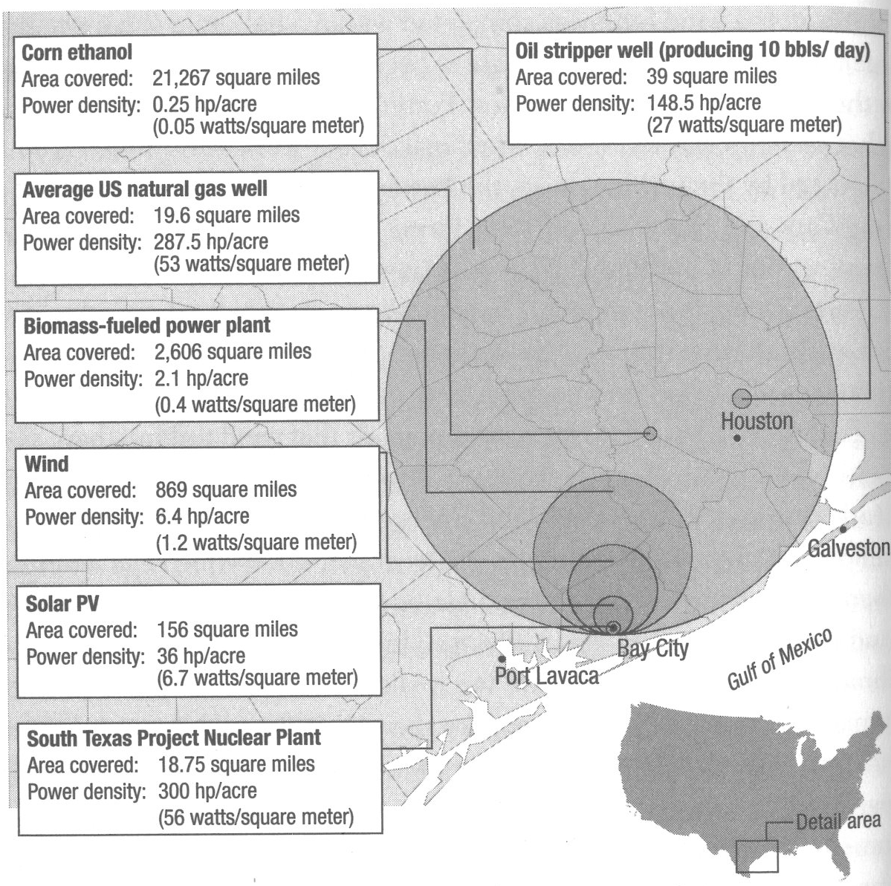
Energy Density
Bryce, Robert. Power Hungry: THE MYTHS OF “GREEN” ENERGY AND THE REAL FUELS OF THE FUTURE. New York: PublicAffiairs: 2010.

Slide 4
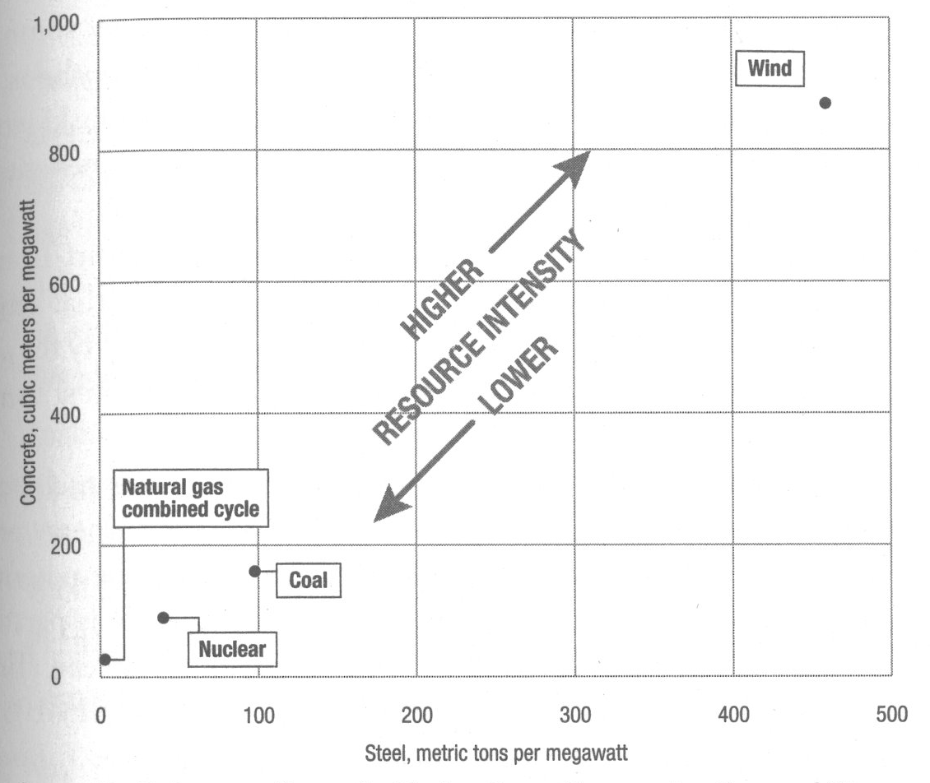
Resource Consumption
Bryce, Robert. Power Hungry: THE MYTHS OF “GREEN” ENERGY AND THE REAL FUELS OF THE FUTURE. New York: PublicAffiairs: 2010.

Slide 5
Questions
About how many metric tons of steel does it take to produce 1 MW of Wind Energy?
Answer: Around 460 metric tons!
Approximately how many times greater is the power density of nuclear compared to wind?
Answer: About 50 time greater!
(300 hp/acre compared to 6.4 hp/ acre)

