Slide 1
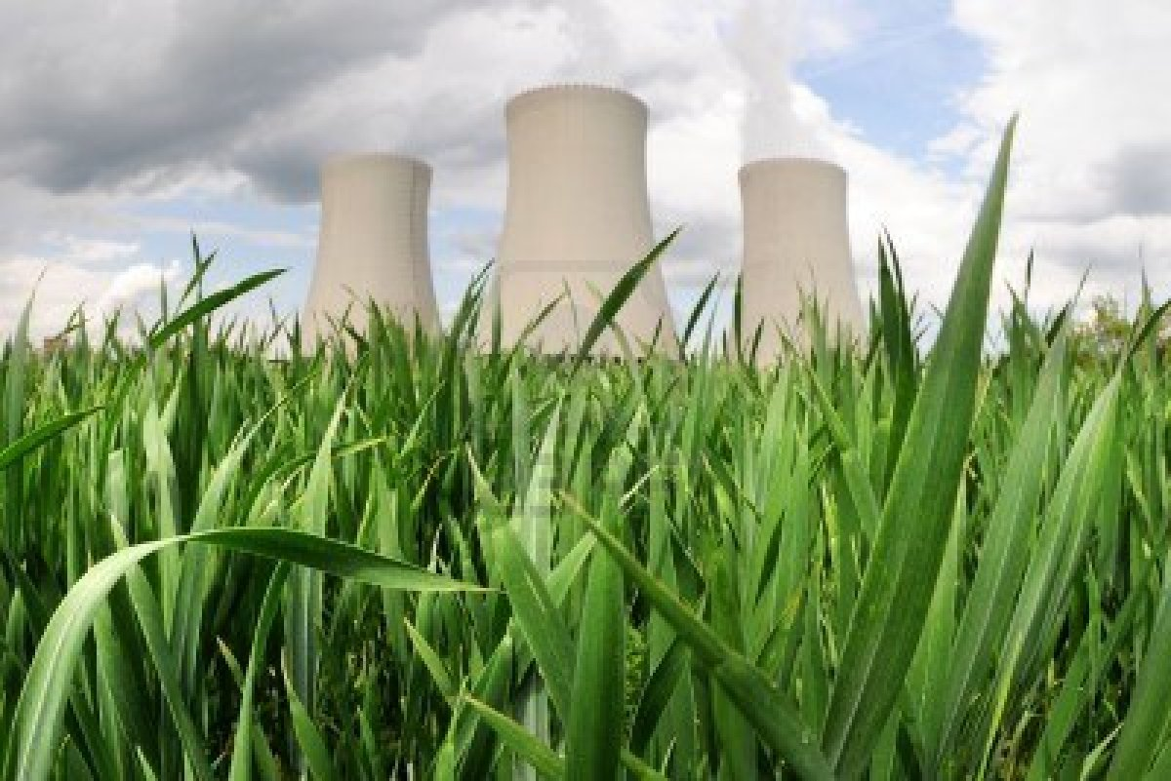
Ch. 26
Nuclear Goes Beyond Green
http://www.123rf.com/photo_5874019_nuclear-power-plant-in-temelin-czech-republic.html
By Bryan Ellefson

Slide 2
Myth: Declining Future
Current Problems
“Nuclear is dying of an Incurable attack of market forces” James Lovelock (1986)
Since 1986
  130 new reactors with 123,000 megawatts capacity
  This is 1/3 of the global nuclear capacity

Slide 3
Benefits
Nuclear is cheaper than renewable sources
No carbon emissions
Does not need a backup power source
Lower long term operation costs
Higher Energy Density
Power Hungry, Robert Bryce, pg 262

Slide 4
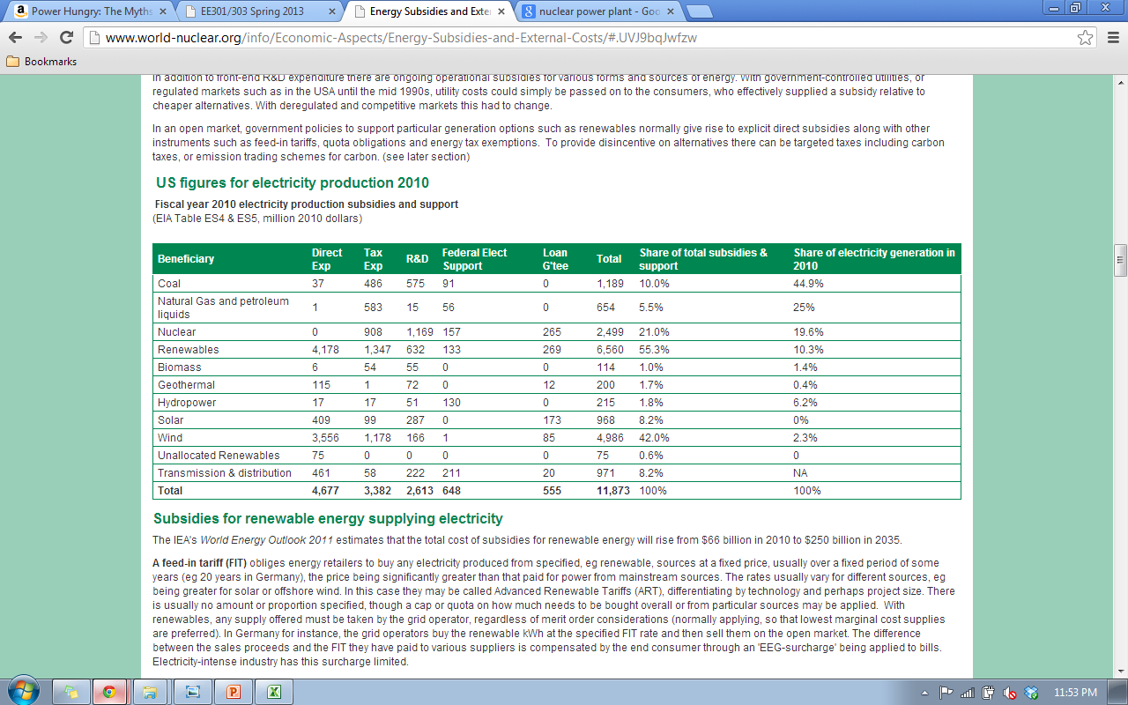
Problems
Image
Agencies Representing Nuclear Power
Federal Subsidies
http://www.world-nuclear.org/info/Economic-Aspects/Energy-Subsidies-and-External-Costs/#.UVJ9bqJwfzw

Slide 5
Questions
How much of the global nuclear capacity does the U.S. have?
What are some of the benefits of nuclear power over renewables and coal?

Slide 6
Questions ?
References
Bryce, Robert. (2010). Power hungry: The myths of "green" energy and the real fuels of the future. Public Affairs.
(2013). Energy subsidies and external costs. World Nuclear Association, Retrieved from http://www.worldnuclear.org/info/Economic-Aspects/Energy- Subsidies-and-External-Costs/

