Slide 1
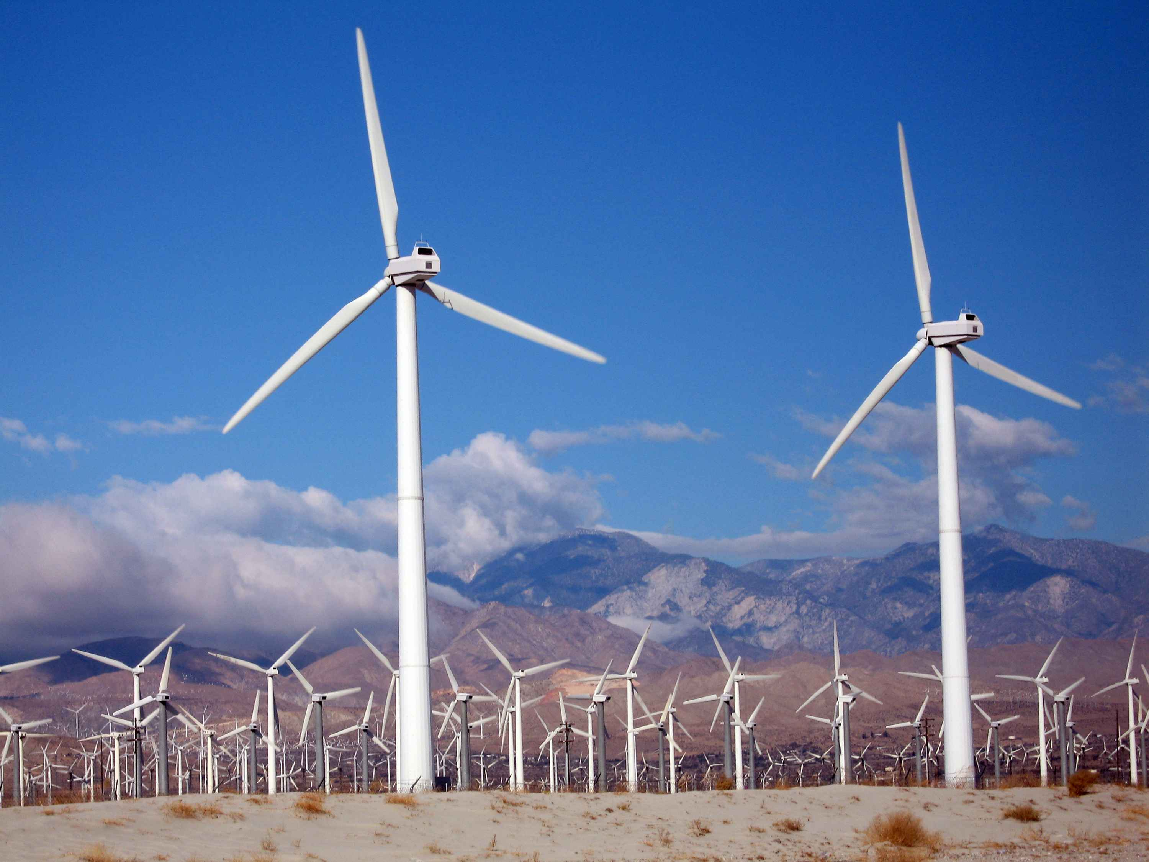
Chapter 12 Power Hungry
Michelle Jensen

Slide 2
Chapter 12 Wind Power reduces the need for Natural Gas
Pickens Plan relies on the theory that increasing the use of wind power will allow the U.S to reduced it’s imports. Basically he feels more wind turbines means natural gas can be redirected to the transportation sector.

Slide 3
Problems with the Pickens's Plan
U.S. natural gas fired electricity is growing
The U.S doesn’t have nearly enough natural gas powered vehicles to make a significant dent in oil imports.

Slide 4
Us Department of Energy: Energy Efficiency and Renewable Energy
574 CNG stations in the United States

Slide 5
Main problem for Pickens’ Plan
Wind is not a constant source of power production.
In Colorado wind power declined 485MW in one hour causing the electric utilities to scramble to keep the lights on as the morning peak was being reached. Gas-fired backups were started quickly as well as electricity was purchased from neighboring utilities.

Slide 6
For Example
From January 14-25, 2009 the Bonneville Power Administration, which supplies electricity to eastern Washington and Oregon.
For this specific example, the lack of wind generated power was due to extreme temperature inversion conditions. This area of the country was able to fall back on hydropower.

Slide 7
To incorporate wind power to the electric grid
For every MW of wind powered added to the electricity system, a MW of gas fired generation must be added to back it up.
Gas Fired generation means investments in (1) gas wells, (2) gas pipeline, and (3) gas storage fields.

Slide 8
An Example when Wind must be added to power grid
Gas-fired powered plants operate at 36% of the time.
(coal is 70% while nuclear is 90%)
When adding wind, the gas-fired generators are used less, lowering their capacity factor t0 25-30%. By reducing the amount the generators are used, the efficiency declines, and the effective equipment cost increases.

Slide 9
Example when there are no wind mandates
The gas turbines could operate at their capacity factor of 36% or higher. Because they are in use, there will be a return on their initial investment.
With added wind turbines, gas turbine utilization decreases making them less efficient from a capitol standpoint.

Slide 10
A report in December 2008 by Xcel Energy (a natural gas and electric utility that services eight states) said the utility expects costs of wind integration to be predominantly fuel costs from
The inefficiency of generation due to the varying wind generation
The cost of additional gas storage, gas pipelines
Up until this point, there have been no comprehensive studies exploring how increased wind power will affect natural gas infrastructure and demand.

Slide 11
The gas related investments due to the addition of wind turbines to the electric grid will be
Paid for: By the consumer
With a higher Power Bill

Slide 12
Wind Turbines would have to be carefully integrated into the power grid.
Wind Turbines are not a replacement for power plants and as we have just learned they actually required a 1:1 ratio back up with gas-fired generators.
Pickens has continually understated costs of moving forward with wind energy.
As for the costs, the new gas-fired generation costs must be included!
Pickens has confused the issues of wind generation and oil by saying and increase in wind energy will allow us to import less.
What about China’s stronghold on neodynium?

Slide 13
Questions
For every MW of wind power on the electric grid, how many MW of gas-fired generation must be there to back it up?
What is the Main Problem with wind generated power?

